Slide 1
Using Machine Learning to Diagnose Lung Cancer
Rebecca Davidson
Abigail Janvier
Dylan Mcgullam
Dami Shobo

Slide 2
Project Progression
Choosing a dataset.
Cleaning the data using Pandas.
Create visualizations of raw data in Tableau.
Use Machine Learning to create a model that would indicate the possibility of lung cancer, low, medium, or high possibility.
Perform PCA and then logistic regression and Random Forest models using only PCs.
Perform logistic regression, Random Forest, and KNN models using all symptoms and environmental exposures.
Use the model with highest accuracy score to make predictions in real time.

Slide 3
Lung Cancer
symptoms are similar to other prevalent respiratory diseases
detection and treatment rely heavily on image analysis and manual testing mechanisms
only highly trained personnel are qualified to provide a diagnosis
We propose to create a model that is able to assess a variety of symptoms and determine if the patient is at high, medium, or low risk of developing lung cancer.

Slide 4
Data: https://data.world/cancerdatahp/lung-cancer-data/workspace/file?filename=cancer+patient+data+sets.xlsx
1000 patients rating the following symptoms and environmental exposures:
Age (14-73)
Gender (1-2)
Air pollution (1-8)
Alcohol use (1-8)
Dust allergy (1-8)
Occupational hazards (1-8)
Genetic risk (1-7)
Chronic lung disease (1-7)
Balanced diet (1-7)
Obesity (1-7)
Smoking (1-8)
Passive smoker (1-8)
Chest pain (1-9)
Coughing of blood (1-9)
Fatigue (1-9)
Weight loss (1-8)
Shortness of breath (1-9)
Wheezing (1-8)
Swallowing difficulty (1-8)
Clubbing of finger nails (1-9)
Frequent cold (1-7)
Dry Cough (1-7)
Snoring (1-7)

Slide 5
Visualizations on Tableau

Slide 6
Cleaning the data using Pandas
Changed Low, Medium, and High classification level to 1, 2, 3
Ran .corrwith() to look for correlations between symptoms and classification level
Excluded symptoms with <30% correlation, accounted for 6 out of 23 symptoms and environmental exposures.

Slide 7
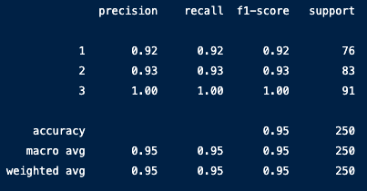
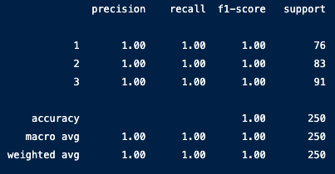
Unsupervised Machine Learning
Logistic Regression w/ 6 PCs
Random Forest w/ 6 PCs
Principal Component Analysis (PCA)

Slide 8
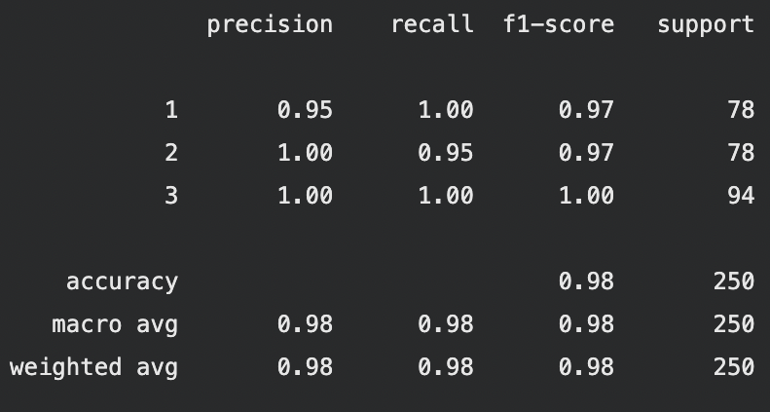
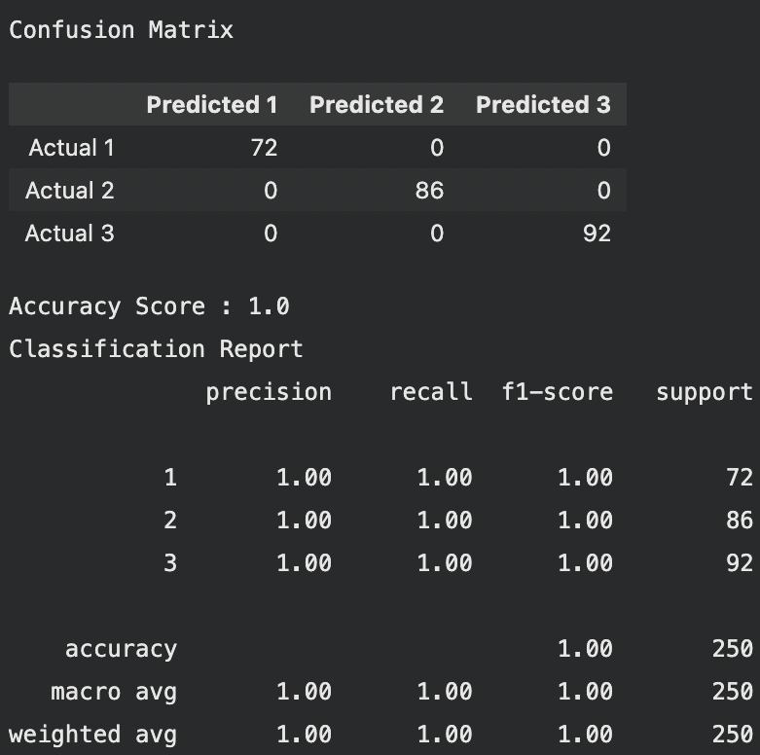
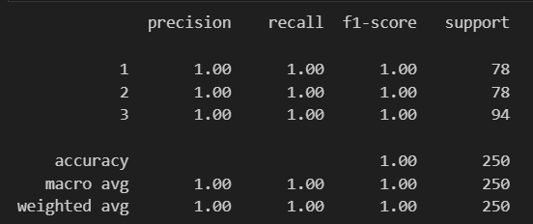
Supervised Machine Learning
Logistic Regression using all data
Random Forest using all data KNN using all data
Logistic Regression
Random Forest
KNN
-using all symptoms

Slide 9
Using the model in real time
Run the model in real time by inputting values for symptoms and environmental exposures.

Slide 10
Questions?
Thank you!

